Slide 1
Personal financial planner
Knowing where your money goes is the first step to financial freedom.
Leonora Siljanovska - 221115

Slide 2
INTRODUCTION
This project is a simple personal finance planner built using modern frontend technologies.
It allows users to:
-Log daily expenses with categories
-Automatically calculate savings and spendable income
-View summaries by category
-Export data to Excel for further analysis
The goal is to help users become more aware of their financial habits and improve budgeting.

Slide 3
Development tools
✔ Vue.js
✔ Local Storage for persistence
✔ HTML, CSS, JavaScript
✔ ExcelJS for export
Used as the main frontend framework to build dynamic and reactive user interfaces for managing expenses and financial data.
All user data, including income, expenses, and categories, is stored in the browser's Local Storage to ensure data persists across sessions without a backend.
Core web technologies used to design the structure (HTML), style (CSS), and implement functionality (JavaScript) of the app.
Allows exporting the user’s financial data into a styled Excel file with headers, totals, and alignment for offline analysis and reports.

Slide 4
HOW IT WORKS
VISUALIZATION AND EXPORT
USER AUTHENTICATION
DATA INSERTION
The app displays detailed tables summarizing expenses by category alongside clear charts that visualize spending patterns and savings over time, with an option to export all this data to Excel for easy tracking and analysis.
Each user logs in with their credentials. The app loads personal financial data using localStorage.
Users enter monthly income and categorize their expenses (Food, Utilities, etc.).
All data is saved locally.

Slide 5
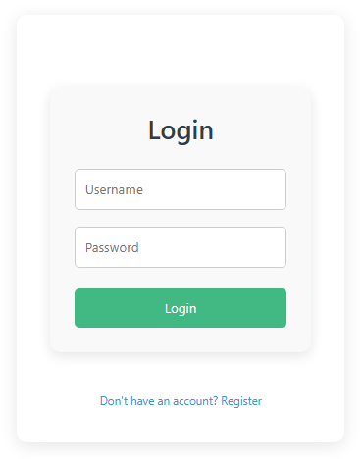
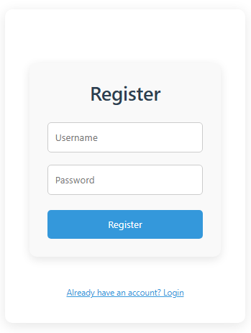
1. USER AUTHENTICATION

Slide 6
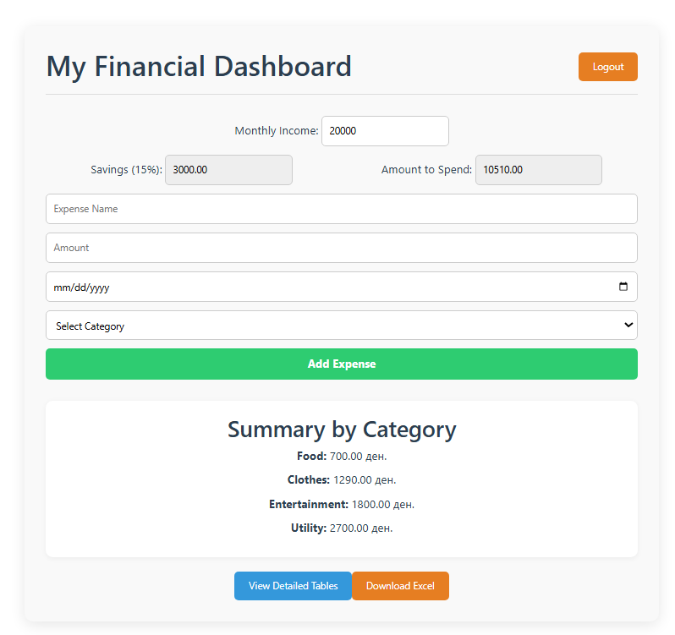
2. DATA INSERTION

Slide 7
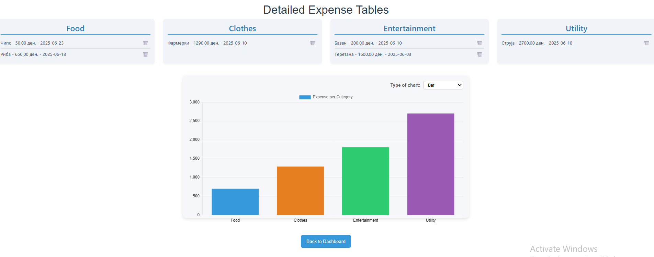
3. VIZUALIZATION

Slide 8
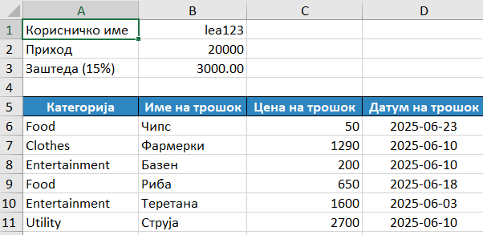
4. EXPORT

Slide 9
USER EXPERIENCE HIGHLIGHTS
The app features a clean and intuitive interface designed for easy navigation. Users can quickly add expenses, view summaries, and export data without hassle, making financial management simple and efficient for everyone.
Easy-to-use expense input with categorized options
Clear visual summaries through tables and charts
Quick export to Excel for offline analysis
Responsive design suitable for all user levels

Slide 10
THANKS
Gitlab and Github repositories:
https://gitlab.finki.ukim.mk/221115/personal-financial-planner/-/tree/main?ref_type=heads
https://github.com/leonorasiljanovska/Financial_Planner_Web/tree/master

